Slide 1


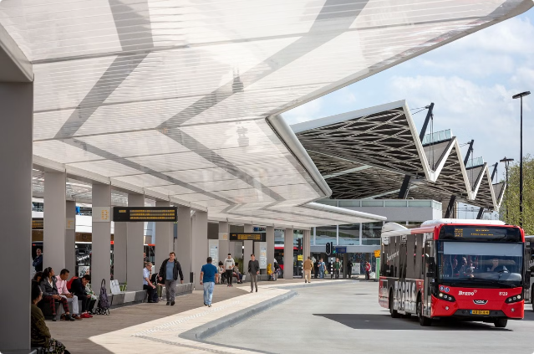
Online Bus Booking System
This system aims to provide a convenient and efficient platform for booking bus tickets online.
By Mancha Pavan Kumar [192210408]
SRINIVAS REDDY [192210136]

Slide 2

Abstract
The Online Bus Booking System simplifies the bus ticket booking process for users. Users can search for available buses, compare prices, and book tickets online.
1
Accessibility
2
Efficiency
The system is accessible from anywhere with an internet connection, eliminating the need for physical visits.
Booking tickets online saves time and effort compared to traditional methods.
3
Convenience
4
Security
Users can easily compare routes, prices, and timings, making the booking process smooth.
The system employs secure payment gateways to ensure the safety of user transactions.

Slide 3
Existing System
Traditional bus ticket booking often involves visiting a physical ticket counter or calling a travel agency.
Limitations
Challenges
Opportunities
This system is time-consuming and inconvenient, especially for people with busy schedules.
Users often face difficulties finding the desired routes and timings.
An online system can overcome these challenges and provide a more efficient solution.
Limited options for routes and timings
Limited availability of online information
Real-time updates on bus availability and timings
Lack of real-time information
Lack of online payment options
Online payment processing for secure transactions
Potential for long queues and wait times
Inability to compare prices and services
Enhanced customer service and support

Slide 4

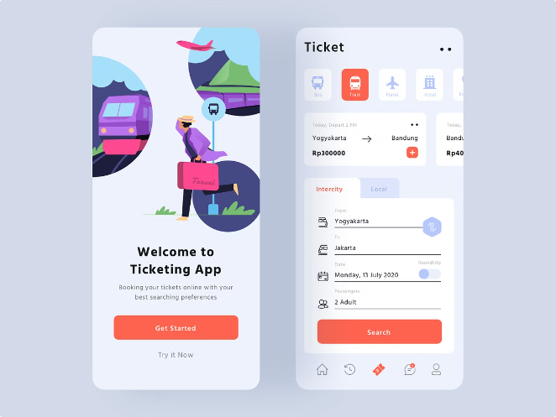
Proposal System
The proposed Online Bus Booking System utilizes a user-friendly web application with a responsive interface.
User Registration
Users can create accounts and manage their profile information.
Route Search
Users can search for available buses based on their origin, destination, and preferred timings.
Ticket Booking
Users can select their desired seats, choose payment methods, and book tickets online.
Ticket Management
Users can access their booked tickets, view details, and manage their bookings.

Slide 5

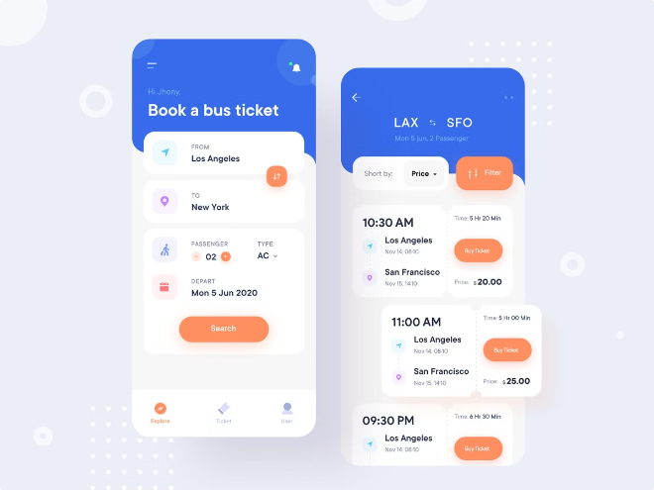
Modules Description
The system is designed with various modules to facilitate a seamless user experience.
1
User Management Module
Handles user registration, login, and profile management.
2
Route Management Module
Manages bus routes, timings, and seat availability.
3
Booking Management Module
Processes ticket bookings, payments, and ticket issuance.
4
Reporting Module
Generates reports on bookings, revenue, and performance metrics.

Slide 6
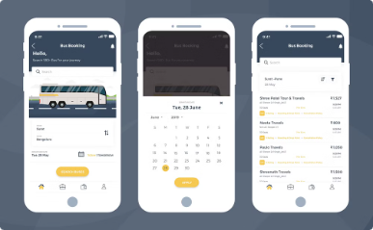
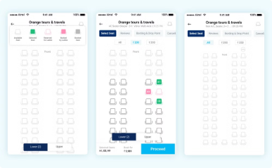
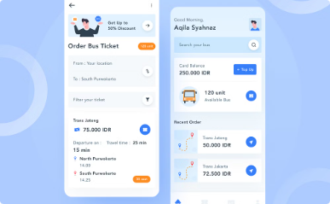
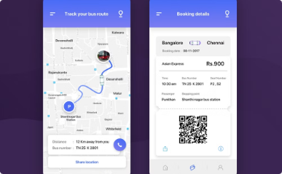
Screen Shots
The system provides a visually appealing and intuitive interface for users.
Search Screen
Seat Selection
Payment Screen
Confirmation Screen
Displays options for searching based on origin, destination, and date.
Allows users to view available seats and make their selection.
Provides various payment options for secure transactions.
Displays booking confirmation details and ticket information.

Slide 7

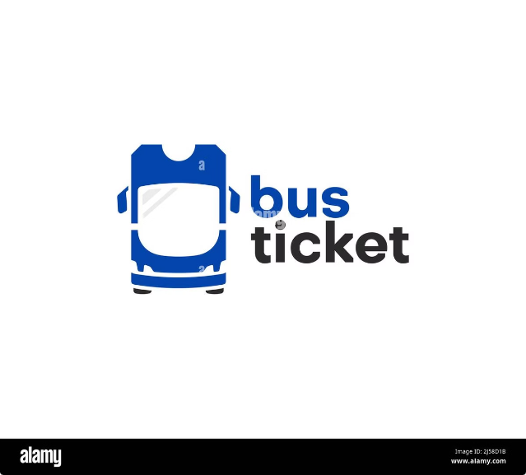
Conclusion
The Online Bus Booking System offers a convenient, efficient, and secure platform for booking bus tickets online.
Reduced manual processes
Enhanced customer satisfaction
Increased efficiency and productivity
Real-time information and updates
Improved access to bus travel information
Streamlined booking process

Slide 8


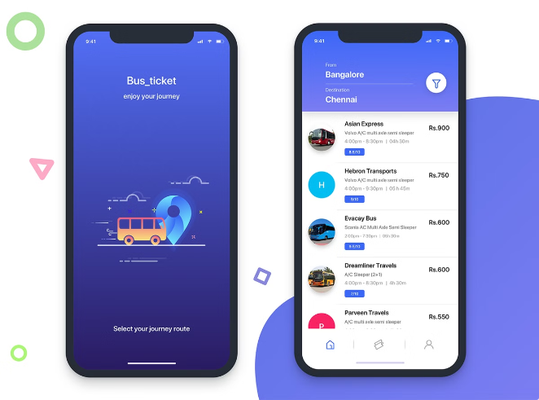



Future Enhancement
Further enhancements can be implemented to improve the system's functionality and user experience.
Integration with GPS
Real-time bus tracking and location updates.
Mobile App Development
Enhanced accessibility and user-friendliness.
Customer Feedback
Improved features based on user feedback and suggestions.
Social Media Integration
Enhanced user engagement and community building.

Slide 9

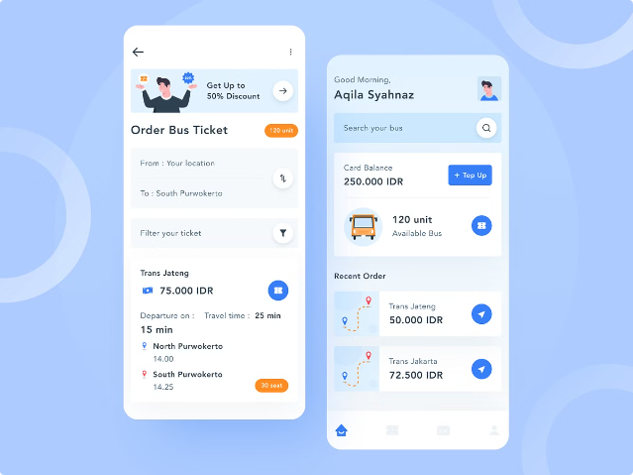
References
This document incorporates research and insights from various sources, including industry best practices and relevant publications.
"Bus Ticket Booking System" by GitHub (a sample project)
"Online Bus Reservation System" by ResearchGate
"Bus Ticket Booking System" by CodeProject (a tutorial)
"Online Bus Ticket Booking System" by Semantic Scholar (a research paper)
"Bus Booking System" by Tutorialspoint (a tutorial)

